Slide 1
PART II. Methods for Causal Inference

Slide 2
PART II. Methods for Causal Inference
Observational Studies
Natural Experiments
Refutations

Slide 3
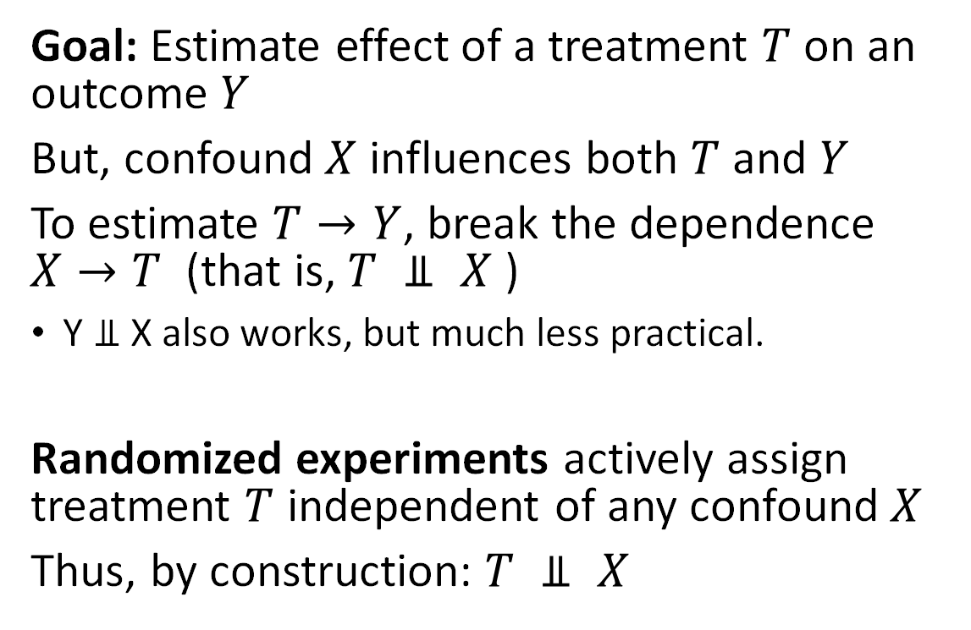
Review: Treatment, Outcome and Confound
X
Goal: Estimate effect of a treatment $T$ on an outcome $Y$
But, confound $X$ influences both $T$ and $Y$
To estimate $T→Y$, break the dependence $X→T$ (that is, $T ⫫ X$ )
Y $⫫$X also works, but much less practical.
Randomized experiments actively assign treatment $T$ independent of any confound $X$
Thus, by construction: $T ⫫ X$
T
Y
X
T
Y

Slide 4
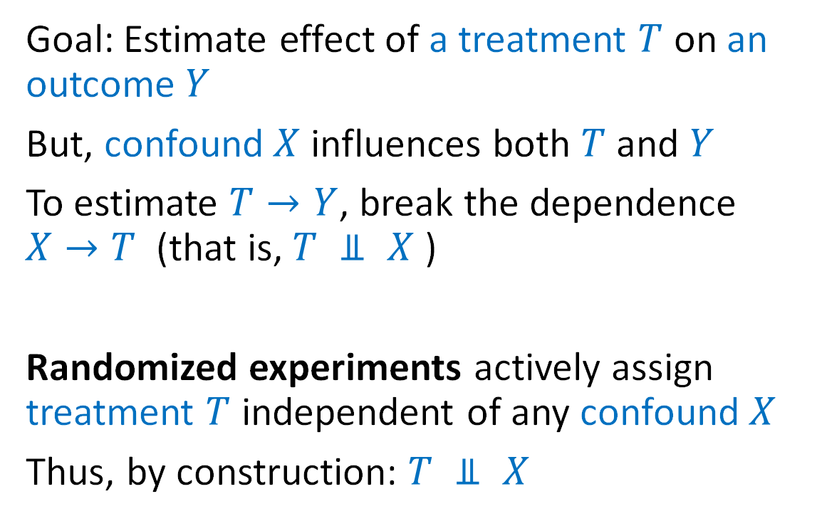
Review: Treatment, Outcome and Confound
X
Goal: Estimate effect of a treatment $T$ on an outcome $Y$
But, confound $X$ influences both $T$ and $Y$
To estimate $T→Y$, break the dependence $X→T$ (that is, $T ⫫ X$ )
Randomized experiments actively assign treatment $T$ independent of any confound $X$
Thus, by construction: $T ⫫ X$
T
Y
X
T
Y

Slide 5
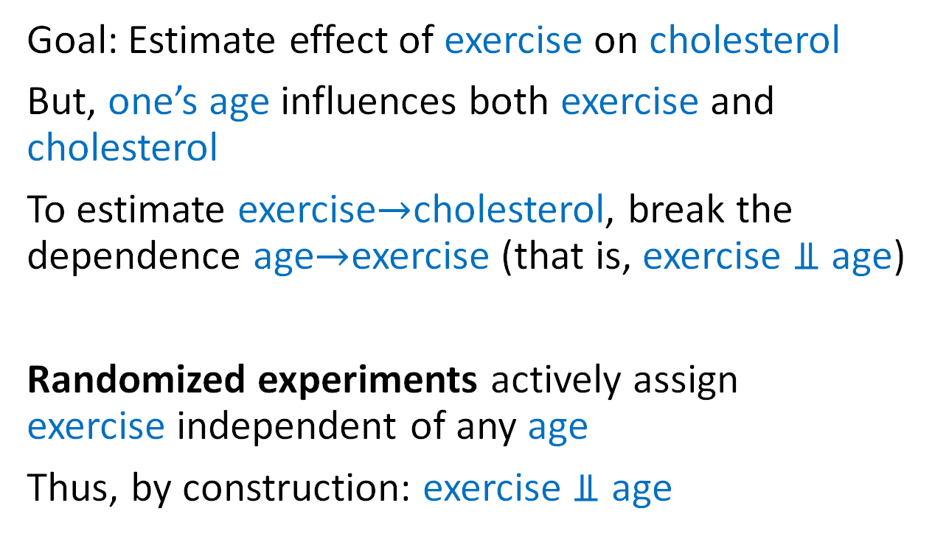
Review: Exercise, Cholesterol, and Age
Running example
Goal: Estimate effect of exercise on cholesterol
But, one’s age influences both exercise and cholesterol
To estimate exercise$→$cholesterol, break the dependence age$→$exercise (that is, exercise $⫫$ age)
Randomized experiments actively assign exercise independent of any age
Thus, by construction: exercise $⫫$ age
Age
Exercise
Cholesterol

Slide 6
Review: Exercise, Cholesterol, and Age
Running example
Goal: Estimate effect of exercise on cholesterol
But, one’s age influences both exercise and cholesterol
To estimate exercise$→$cholesterol, break the dependence age$→$exercise (that is, exercise $⫫$ age)
Randomized experiments actively assign exercise independent of any age
Thus, by construction: exercise $⫫$ age
Age
But, what if we cannot actively intervene?
Exercise
Cholesterol

Slide 7
Part II.A. Observational Studies “Simulating randomized experiments"
Conditioning on Key Variables
Matching and Stratification
Weighting
Regression
Doubly Robust
Synthetic Controls

Slide 8
Part II.A. Observational Studies “Simulating randomized experiments"
Conditioning on Key Variables
Matching and Stratification
Weighting
Regression
Doubly Robust
Synthetic Controls

Slide 9
Cholesterol
Stationary Biking

Slide 10
Cholesterol
Stationary Biking

Slide 11
Age
40
35
30
25
Cholesterol
20
Stationary Biking

Slide 12
Age
40
35
30
25
Cholesterol
20
Stationary Biking

Slide 13
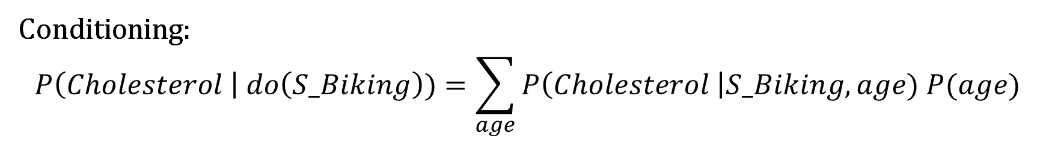
Recapping what just happened
At first, more stationary biking seems to lead to higher cholesterol
But, we realize that there is a confounder, age, that influences both stationary biking and cholesterol
We condition on age (by analyzing each age group separately)
And find stationary biking now seems to lead to lower cholesterol
Conditioning:
$$P\left(Cholesterol \right| do\left(S_Biking\right))=\sum_{age}{P\left(Cholesterol \right|S_Biking, age) P(age)}$$

Slide 14
What are the assumptions we made?
Assumption: age is the only confounder
“Ignorability” or “selection on observables” assumption
How do we know what we must condition on?
Assumption: effect of stationary biking doesn’t depend on friends’ exercise
Stable Unit Treatment Value (SUTVA) assumption
Are there network effects?
Assumption: our observations of exercise/no-exercise cover similar people
“Common support” or “Overlap” assumption
Also: data is not covering all combinations of age and levels of exercise
Will our lessons generalize beyond the observed region?

Slide 15
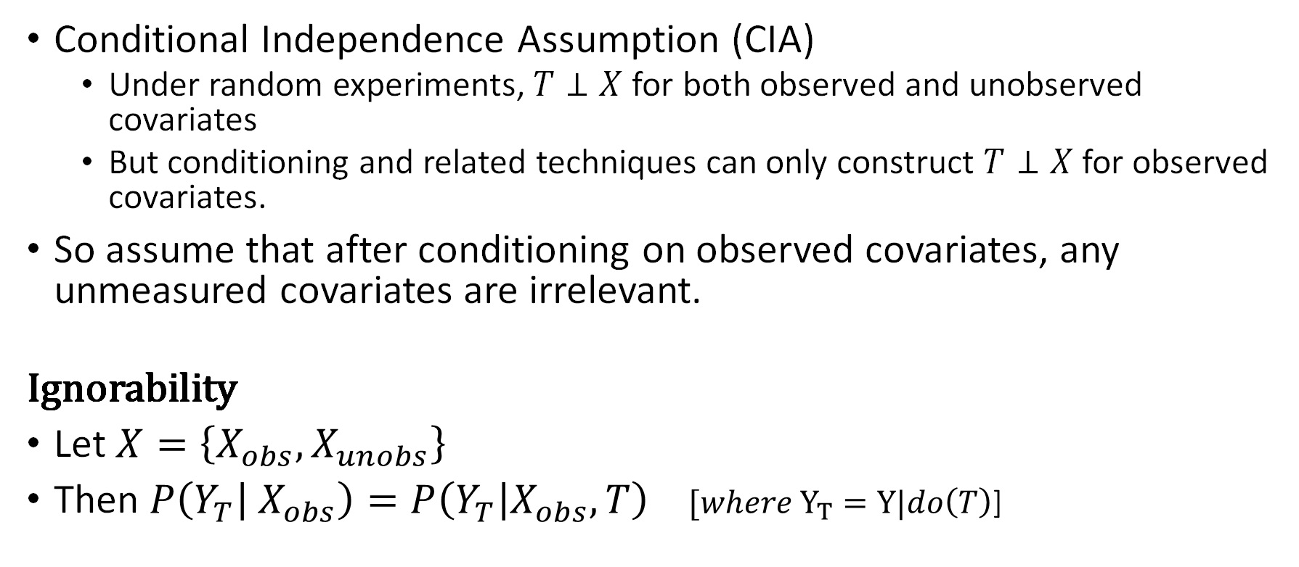
A1: Ignorability
Conditional Independence Assumption (CIA)
Under random experiments, $T⊥X$ for both observed and unobserved covariates
But conditioning and related techniques can only construct $T⊥X$ for observed covariates.
So assume that after conditioning on observed covariates, any unmeasured covariates are irrelevant.
Ignorability
Let $X=\left\{X_{obs},X_{unobs}\right\}$
Then $P\left(Y_{T} | X_{obs}\right)=P\left(Y_{T} | X_{obs},T\right)$ $[where Y_{T}=Y|do\left(T\right)$]

Slide 16
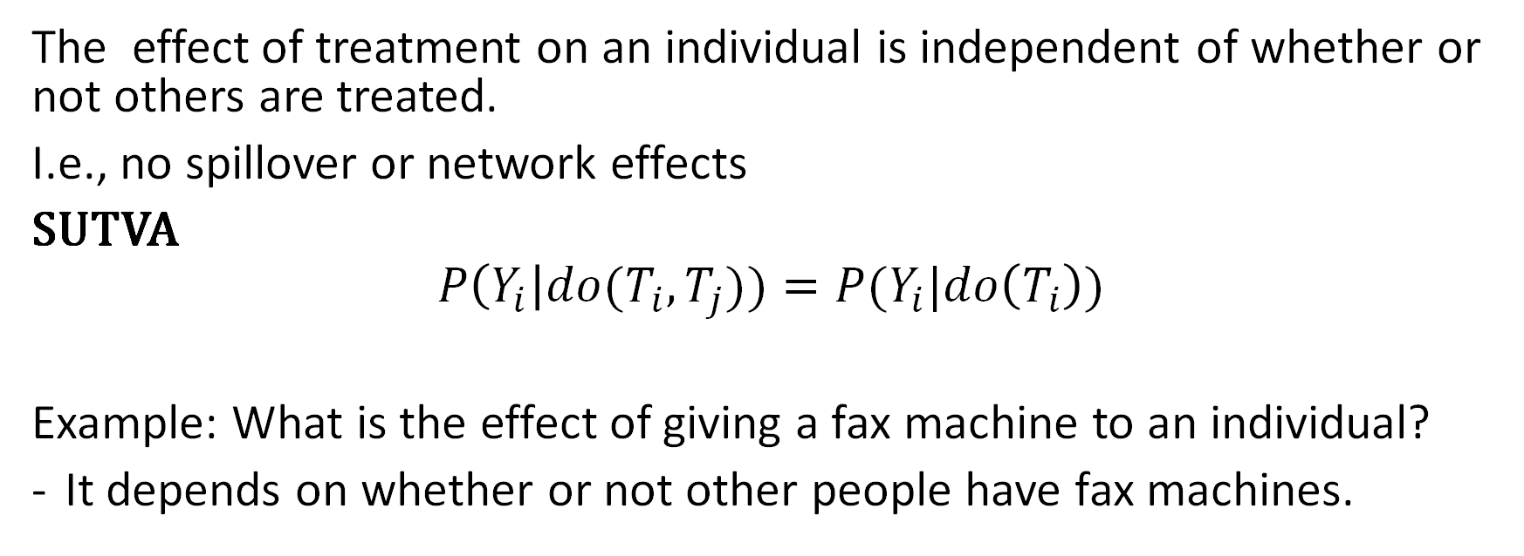
A2. Stable Unit Treatment Value
The effect of treatment on an individual is independent of whether or not others are treated.
I.e., no spillover or network effects
SUTVA
$$P\left(Y_{i}\right|do{(T}_{i},T_{j}))=P(Y_{i}|do\left(T_{i}\right))$$
Example: What is the effect of giving a fax machine to an individual?
It depends on whether or not other people have fax machines.
Do people here know / remember what a fax machine is?

Slide 17




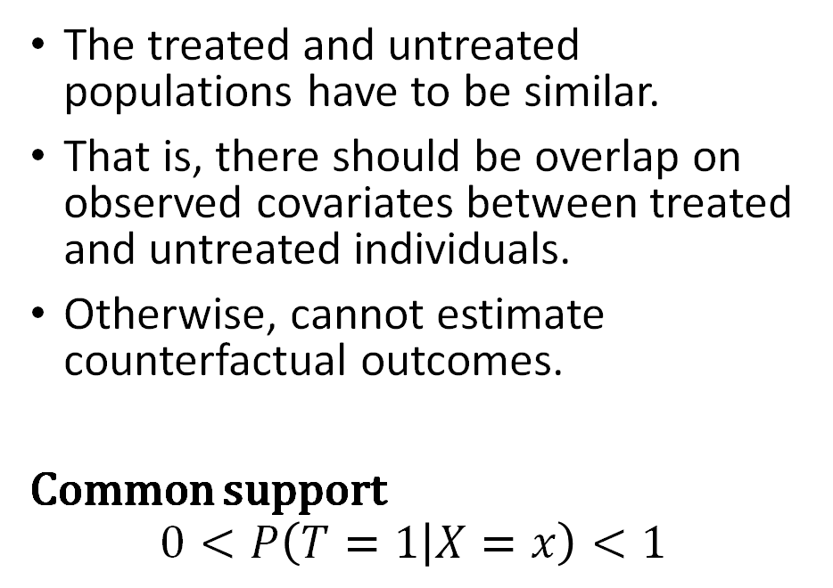
A3. Common support
The treated and untreated populations have to be similar.
That is, there should be overlap on observed covariates between treated and untreated individuals.
Otherwise, cannot estimate counterfactual outcomes.
Common support
$$0<P\left(T=1 | X=x\right)<1$$

Slide 18
Advanced: How to know we have the right variables? Backdoor criterion
1. Use domain knowledge to build a model of the causal graph 2. Condition on enough variables to cover all backdoor paths
Occupation
Income
Diet
Age
Exercise
Cholesterol
Caveat: Causal effect only if assumed graphical model is correct

Slide 19
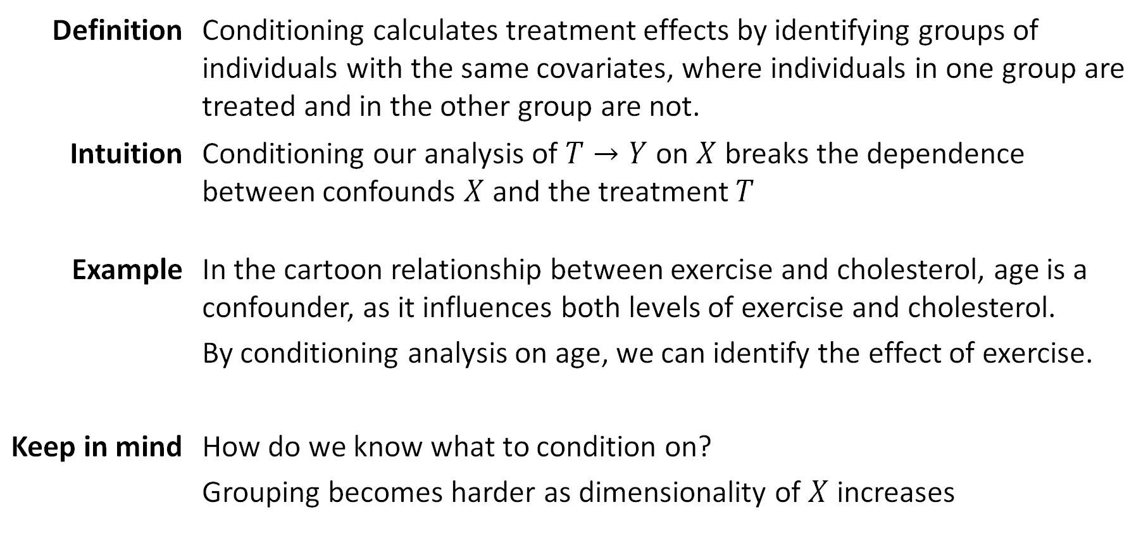
What we just learned: Simple Conditioning
Definition | Conditioning calculates treatment effects by identifying groups of individuals with the same covariates, where individuals in one group are treated and in the other group are not.
Intuition | Conditioning our analysis of $T→Y$ on $X$ breaks the dependence between confounds $X$ and the treatment $T$
Example | In the cartoon relationship between exercise and cholesterol, age is a confounder, as it influences both levels of exercise and cholesterol. By conditioning analysis on age, we can identify the effect of exercise.
Keep in mind | How do we know what to condition on? Grouping becomes harder as dimensionality of $X$ increases

Slide 20
Part II.A. Observational Studies “Simulating randomized experiments"
Conditioning on Key Variables
Matching and Stratification
Weighting
Simple Regression
Doubly Robust
Synthetic Controls

Slide 21
Avg Cholesterol = 200
Avg Cholesterol = 206

Slide 22
:
:
:
:
:
:
:
:
:
:
:
:
:

Slide 23
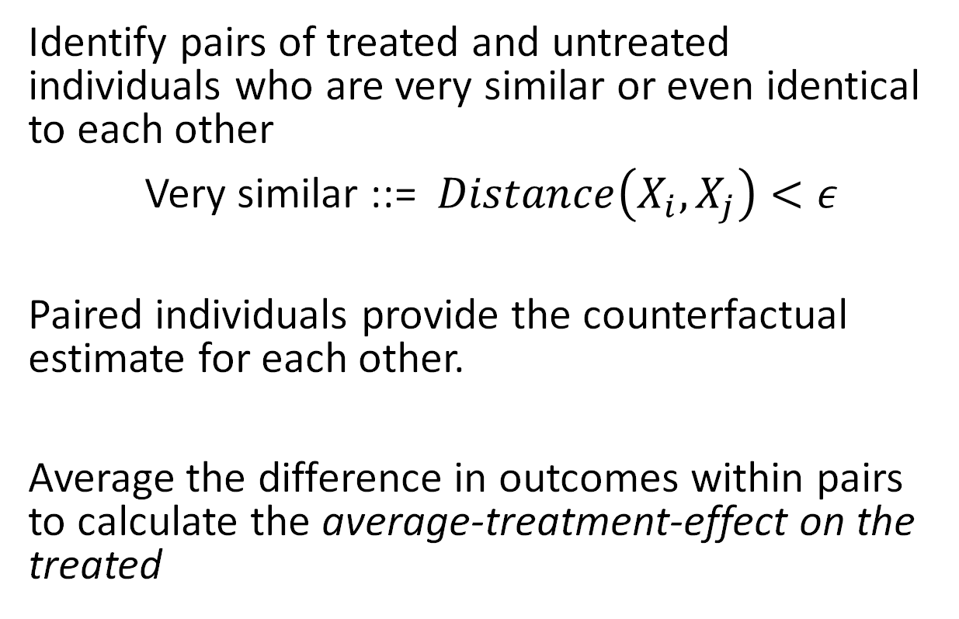
Matching
Identify pairs of treated and untreated individuals who are very similar or even identical to each other
Very similar ::= $Distance\left(X_{i}, X_{j}\right)<ε$
Paired individuals provide the counterfactual estimate for each other.
Average the difference in outcomes within pairs to calculate the average-treatment-effect on the treated
i
j
:

Slide 24
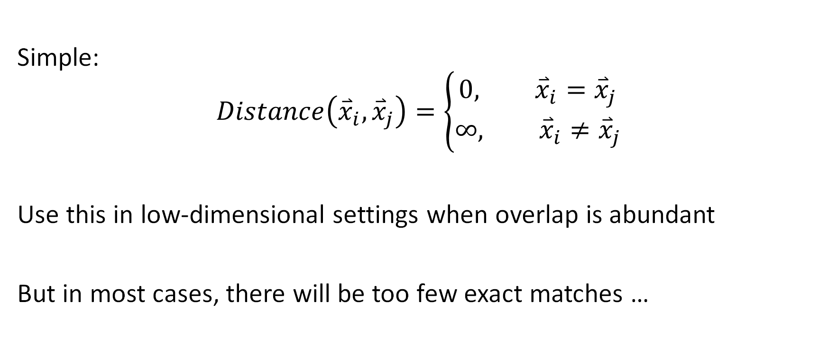
Exact Match
Simple:
$$Distance\left({\overset{⃑}{x}}_{i}, {\overset{⃑}{x}}_{j}\right)=\left\{\begin{aligned}0, {\overset{⃑}{x}}_{i}={\overset{⃑}{x}}_{j} \\ &∞, {\overset{⃑}{x}}_{i}≠{\overset{⃑}{x}}_{j}\end{aligned}\right.$$
Use this in low-dimensional settings when overlap is abundant
But in most cases, there will be too few exact matches …

Slide 25
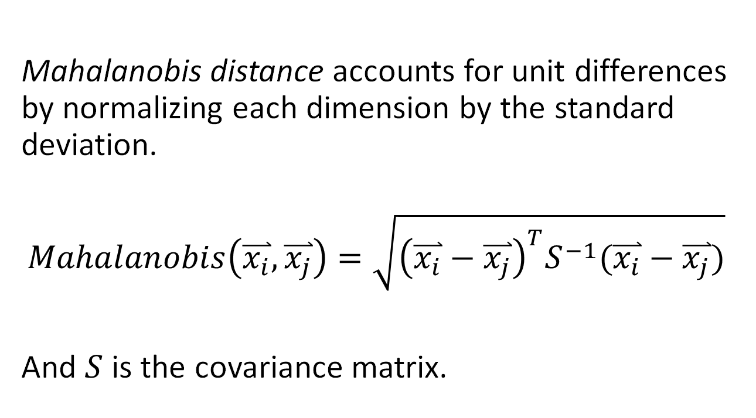
Mahalanobis Distance
Mahalanobis distance accounts for unit differences by normalizing each dimension by the standard deviation.
$$Mahalanobis\left(\overset{⃑}{x_{i}}, \overset{⃑}{x_{j}}\right)=\sqrt{{\left(\overset{⃑}{x_{i}}−\overset{⃑}{x_{j}}\right)}^{T}S^{−1}(\overset{⃑}{x_{i}}−\overset{⃑}{x_{j}})}$$
And $S$ is the covariance matrix.

Slide 26
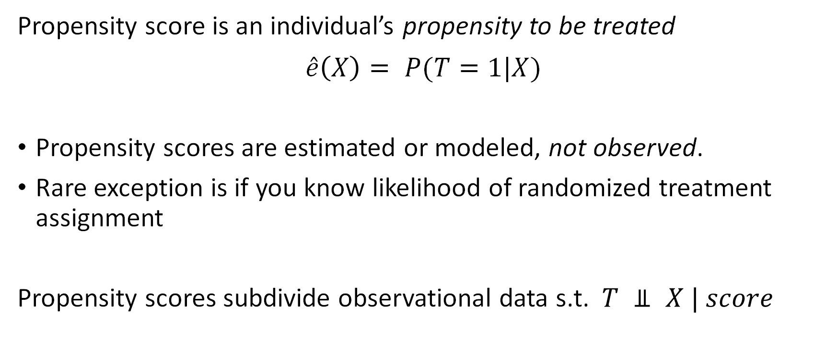
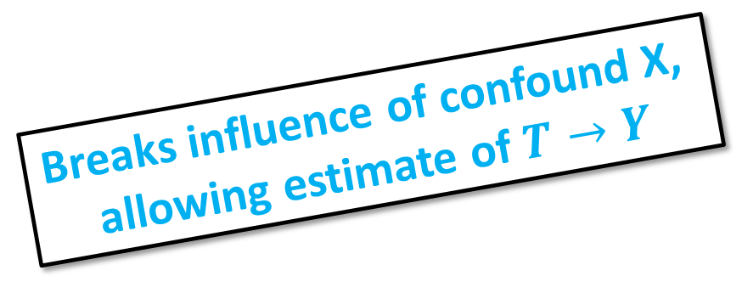
Propensity Score
Propensity score is an individual’s propensity to be treated
$$\hat{e}\left(X\right)= P(T=1|X)$$
Propensity scores are estimated or modeled, not observed.
Rare exception is if you know likelihood of randomized treatment assignment
Propensity scores subdivide observational data s.t. $T ⫫ X | score$
Breaks influence of confound X, allowing estimate of $T→Y$

Slide 27
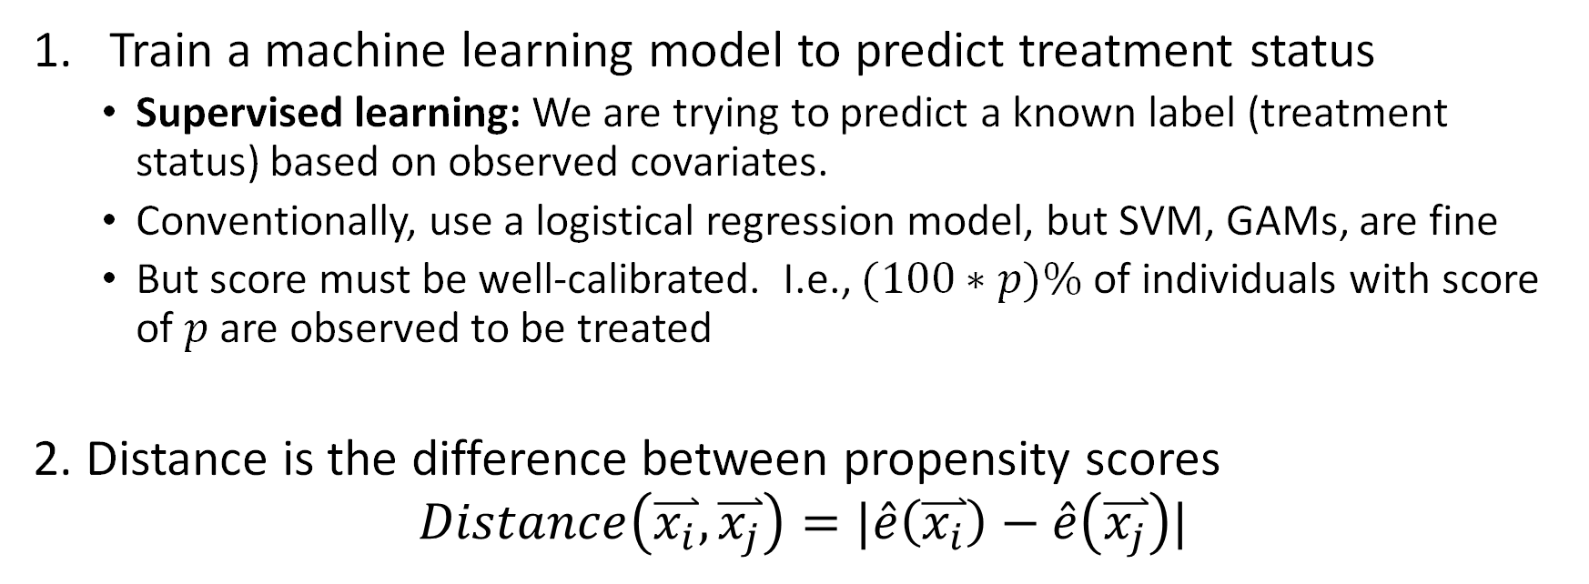
How to match with propensity score
Train a machine learning model to predict treatment status
Supervised learning: We are trying to predict a known label (treatment status) based on observed covariates.
Conventionally, use a logistical regression model, but SVM, GAMs, are fine
But score must be well-calibrated. I.e., $(100∗p)\%$ of individuals with score of $p$ are observed to be treated
2. Distance is the difference between propensity scores
$$Distance\left(\overset{⃑}{x_{i}}, \overset{⃑}{x_{j}}\right)=|\hat{e}\left(\overset{⃑}{x_{i}}\right)−\hat{e}\left(\overset{⃑}{x_{j}}\right)|$$

Slide 28
Propensity score, FAQ
Q: Wait, why does this work?
A: Individuals with similar covariates get similar scores, and all individuals mapped to a similar score have similar treatment likelihoods.
Q: What if my propensity score is not accurate? (i.e., can’t tell who is treated)
A: That’s ok. The role of the model is to balance covariates given a score; not to actually identify treated and untreated.
Q: What if my propensity score is very accurate? (i.e., can tell who is treated)
A: Means we cannot disentangle covariates from treatment status. Any effect we observe could be due either to the treatment or to the correlated covariate.
Consider redefining the treatment or general problem statement. Don’t dumb down model!

Slide 29
Propensity score matching python code
# learn propensity score model
psmodel = linear_model.LinearRegression()
psmodel.fit(covariates, treatment_status)
data['ps'] = psmodel.predict(covariates)
# find nearest neighbor matches
controlMatcher = NearestNeighbors().fit(untreated['ps’])
distances, matchIndex = controlMatch.kneighbors(treated['ps'])
# iterate over matched pairs and sum difference in outcomes
for i in range(numtreatedunits):
treated_outcome = treated.iloc[i][outcome_name].item()
untreated_outcome = untreated.iloc[matchIndex[i]][outcome_name].item()
att += treated_outcome - untreated_outcome
# normalize
att /= numtreatedunits

Slide 30
Advanced: Matching
When matching, should we allow replacement?
It’s a bias / variance trade-off
When matching, what if nearest neighbor is far away?
Use a caliper threshold to limit acceptable distance
What if not all treated individuals are matched to untreated?
This will bias results. Consider redefining original cohort / population to cleanly exclude treated who won’t have matches in untreated population.
Treatment should be a binary point treatment
Advanced variants allow multi-dose, and other treatment regimens

Slide 31
What we just learned: Matching
Definition | Matching calculates treatment effects by identifying pairs of similar individuals, where one is treated and the other is not.
Intuition | The paired individuals stand-in as the counterfactual observations for one another.
Example | In our cartoon, we create pairs of individuals matched exactly on their age. More generally, we can use Mahalanobis distance or propensity score matching to find similar individuals to be matched.
Keep in mind | Matching calculates the treatment effect on the treated population. We do not know what might happen if people who would never get treatment are suddenly treated.

Slide 33
180
180
200
190
240
230

Slide 34
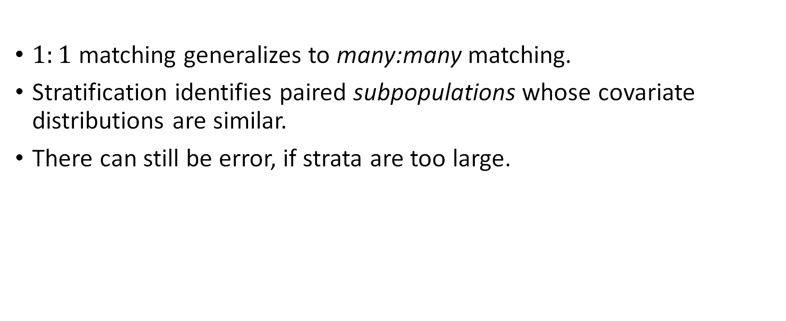
From Matching to Stratification
$1:1$ matching generalizes to many:many matching.
Stratification identifies paired subpopulations whose covariate distributions are similar.
There can still be error, if strata are too large.

Slide 35
How to stratify with propensity score
Train a machine learning model to predict treatment status
Supervised learning: We are trying to predict a known label (treatment status) based on observed covariates.
Conventionally, use a logistical regression model, but SVM, GAMs, are fine
But score must be well-calibrated. I.e., $(100∗p)\%$ of individuals with score of $p$ are observed to be treated
2. Distance is the difference between propensity scores
$$Distance\left(\overset{⃑}{x_{i}}, \overset{⃑}{x_{j}}\right)=|\hat{e}\left(\overset{⃑}{x_{i}}\right)−\hat{e}\left(\overset{⃑}{x_{j}}\right)|$$

Slide 36
Propensity Score Stratification
We can use propensity score to stratify populations
Calculate propensity scores per individual as in matching.
But instead of matching, stratify based on score.
Calculate average treatment effect as weighted average of outcome differences per strata.
Weight by number of treated in the population for ATE on treated.
Propensity = 0.0
Propensity = 1.0

Slide 37
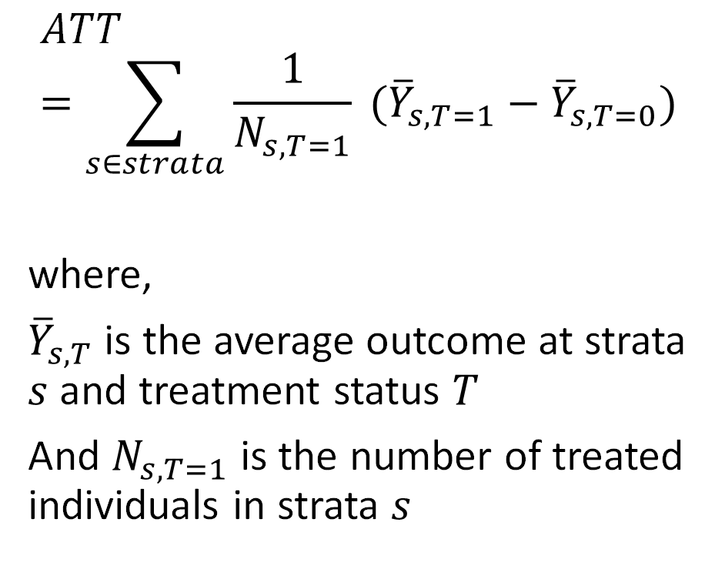
Propensity Score Stratification
$$ATT=\sum_{s∈strata}{\frac{1}{N_{s,T=1}} ({\overline{Y}}_{s,T=1}−{\overline{Y}}_{s,T=0}) }$$
where,
${\overline{Y}}_{s,T}$ is the average outcome at strata $s$ and treatment status $T$
And $N_{s,T=1}$ is the number of treated individuals in strata $s$
Propensity = 0.0
Propensity = 1.0

Slide 38
Propensity score stratification python code
# build propensity score model and assign each item a score as earlier…
# create a column 'strata' for each element that marks what strata it belongs to
data['strata'] = ((data['ps'].rank(ascending=True) / numrows) * numStrata).round(0)
data['T_y'] = data['T'] * data['outcome’] # T_y = outcome iff treated
data['Tbar'] = 1 - data['treated’] # Tbar = 1 iff untreated
data['Tbar_y'] = data['Tbar'] * data['outcome'] # Tbar_y = outcome iff untreated
stratified = data.groupby('strata')
# sum weighted outcomes over all strata (weight by treated population)
outcomes = stratified.agg({'T':['sum'],'Tbar':['sum'],'T_y':['sum'],'Tbar_y':['sum']})
# calculate per-strata effect
outcomes[‘T_y_mean'] = outcomes[‘T_y_sum'] / outcomes['T']
outcomes[‘Tbar_y_mean'] = outcomes[‘Tbar_y_sum'] / outcomes['dbar_sum']
outcomes['effect'] = outcomes[‘T_y_mean'] - outcomes[‘Tbar_y_mean’]
# weighted sum of effects over all strata
att = (outcomes['effect'] * outcomes['T']).sum() / totaltreatmentpopulation

Slide 39
P.S. Stratification, Practical Considerations
How many strata do we pick?
Scale will depend on data. Want each stratum to have enough data in it.
Conventional, small-data literature (e.g., ~100 data points) picked 5.
With 10k to 1M or more data points, I pick 100 to 1000 strata.
Set strata boundaries to split observed population evenly
Aside: why not always pick a small number of strata? It’s a bias-variance trade-off…
What if there aren’t enough treated or untreated individuals in some of my stratum to make a meaningful comparison?
This often happens near propensity score 0.0 and near 1.0
Drop (“Clip”) these strata from analysis. Technically, you are now calculating a local-average-treatment-effect.

Slide 40
What we just learned: Stratification
Definition | Stratification calculates treatment effects by identifying groups of individuals with similar distributions of covariates, where individuals in one group are treated and in the other group are not.
Intuition | The difference in average outcome of paired groups tells us the effect of the treatment on that subpopulation. Observed confounds are balanced, due to covariate similarity across paired groups.
Example | In our cartoon example, we stratified based on propensity score into 3 strata. ATE is the weighted sum of differences in avg outcomes in each strata.
Keep in mind | Make sure there are enough comparable individuals in each strata

Slide 41
Part II.A. Observational Studies “Simulating randomized experiments"
Conditioning on Key Variables
Matching and Stratification
Weighting
Simple Regression
Doubly Robust
Synthetic Controls

Slide 42
Weighting: An alternative to conditioning
What if we assign weights to observations to simulate randomized experiment?
Stratification weights strata results by number of treated
Weighting by treated population ~ weighting by propensity score.
Generalized weighting: Calculate effect by weighted sum over all individual outcomes
Many weighting methods to generate a balanced dataset
Propensity = 0.0
Propensity = 1.0

Slide 43
Weighting
Stratification weights strata results by number of treated
Weighting by treated population ~ weighting by propensity score.
Generalized weighting: Calculate effect by weighted sum over all individual outcomes
Many weighting methods to generate a balanced dataset
Propensity = 0.0
Propensity = 1.0

Slide 44
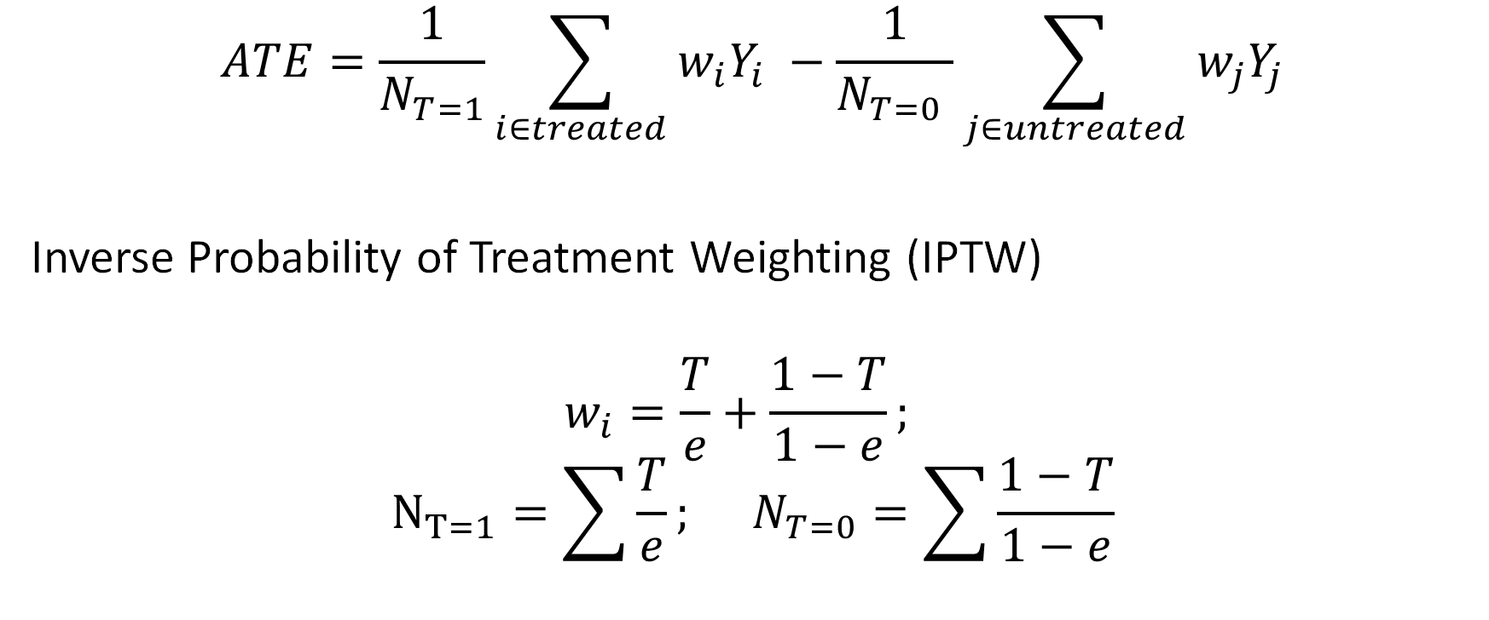
Weighting
$$ATE=\frac{1}{N_{T=1}}\sum_{i∈treated}{w_{i}Y_{i}} −\frac{1}{N_{T=0} }\sum_{j∈untreated}{w_{j}Y_{j}}$$
Inverse Probability of Treatment Weighting (IPTW)
$$w_{i}=\frac{T}{e}+\frac{1−T}{1−e};$$
$$N_{T=1}=\sum_{ }{\frac{T}{e}}; N_{T=0}=\sum{\frac{1−T}{1−e}}$$

Slide 45
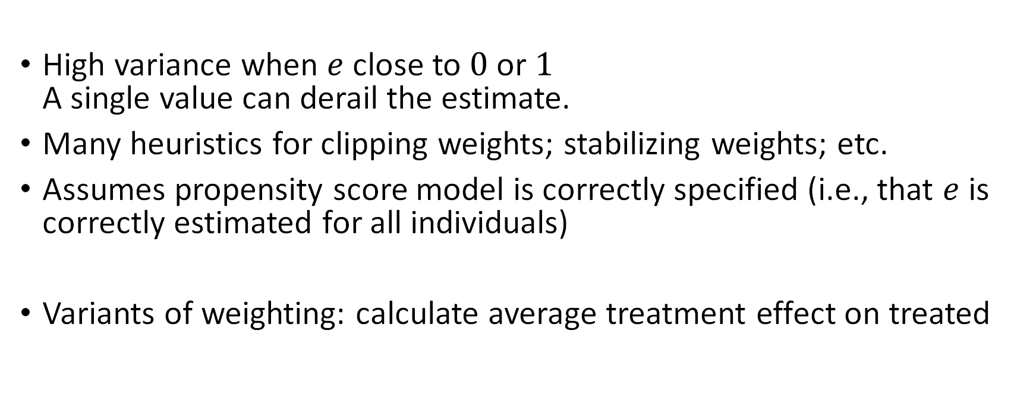
Weighting: Caveats and Practical notes
High variance when $e$ close to $0$ or $1$ A single value can derail the estimate.
Many heuristics for clipping weights; stabilizing weights; etc.
Assumes propensity score model is correctly specified (i.e., that $e$ is correctly estimated for all individuals)
Variants of weighting: calculate average treatment effect on treated

Slide 46
What we just learned: Weighting
Definition | Weighting calculates average treatment effect as the difference between the weighted sum of the treated and untreated populations
Intuition | Weights on each individual act to balance the distribution of covariates in the treated and untreated groups. (i.e., break the dependence between treatment status and covariates)
Keep in mind | High variance when propensity scores are very high or very low Many variants of weighting schemes

Slide 47
Part II.A. Observational Studies “Simulating randomized experiments”
Conditioning on Key Variables
Matching and Stratification
Weighting
Simple Regression
Doubly Robust
Synthetic Controls

Slide 48
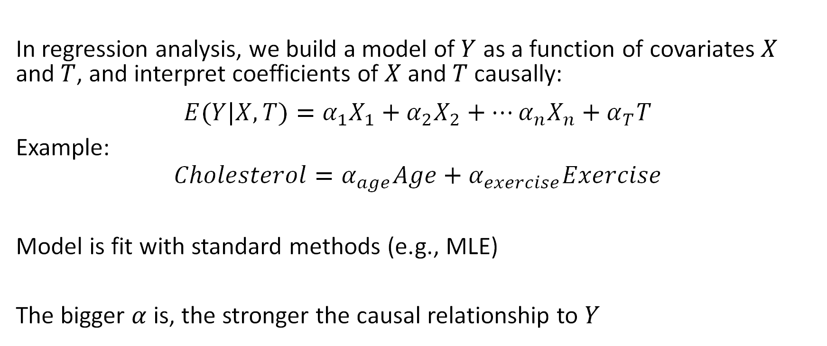
Regression (or supervised learning)
In regression analysis, we build a model of $Y$ as a function of covariates $X$ and $T$, and interpret coefficients of $X$ and $T$ causally:
$$E(Y|X,T)=α_{1}X_{1}+α_{2}X_{2}+…α_{n}X_{n}+α_{T}T$$
Example:
$$Cholesterol=α_{age}Age+α_{exercise}Exercise$$
Model is fit with standard methods (e.g., MLE)
The bigger $α$ is, the stronger the causal relationship to $Y$

Slide 49
Regression warnings
Causal interpretation of regressions requires many assumptions.
Threats to validity include:
Model correctness: e.g., what if we use a linear model and causal relationship is non-linear
Multicollinearity: if covariates are correlated, can’t get accurate coefficients
Ignorability (Omitted variables): Omission of confounds will invalidate findings

Slide 50
What we just learned: Regression
Definition | Use a regression-based causal analysis, we interpret coefficients as the strength of causal relationship
Example | Modeling cholesterol as a function of exercise and age
Keep in mind | Analysis must be carefully designed to ensure causal interpretability, avoiding collinearity and including all relevant confounds Avoid unless you are absolutely sure of what you are doing.

Slide 51
Part II.A. Observational Studies “Simulating randomized experiments"
Conditioning on Key Variables
Matching and Stratification
Weighting
Simple Regression
Doubly Robust
Synthetic Controls

Slide 52
Doubly robust: Best of both worlds?
Both propensity score weighting and regression models require correctly specified models
E.g., if propensity score or regression is modeled as a linear combination, but is non-linear, than it is not correctly specified
Doubly robust methods combine “best of” propensity score and regression methods
If either propensity score or regression is correctly specified, then doubly robust is correct.

Slide 53
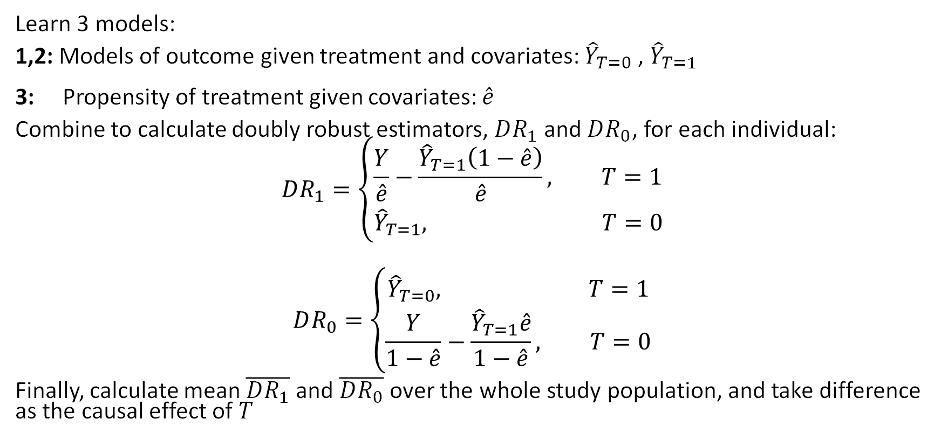
DR: Combines 3 components
Learn 3 models:
1,2: Models of outcome given treatment and covariates: ${\hat{Y}}_{T=0}$ , ${\hat{Y}}_{T=1}$
3: Propensity of treatment given covariates: $\hat{e}$
Combine to calculate doubly robust estimators, $DR_{1}$ and $DR_{0}$, for each individual:
$$DR_{1}=\left\{\begin{aligned}\frac{Y}{\hat{e}}−\frac{{\hat{Y}}_{T=1}\left(1−\hat{e}\right)}{\hat{e}}, T=1 \\ &{\hat{Y}}_{T=1}, T=0\end{aligned}\right.$$
$$DR_{0}=\left\{\begin{aligned}{\hat{Y}}_{T=0}, T=1 \\ &\frac{Y}{1−\hat{e}}−\frac{{\hat{Y}}_{T=1}\hat{e}}{1−\hat{e}}, T=0\end{aligned}\right.$$
Finally, calculate mean $\overline{DR_{1}}$ and $\overline{DR_{0}}$ over the whole study population, and take difference as the causal effect of $T$

Slide 54
Doubly Robust: Caveat
If either propensity score or regression is correctly specified, then doubly robust is unbiased.
Seems like doubly robust should be strictly better (less biased) than either propensity score weighting or regression
But, if both propensity score or regression are slightly incorrect, then doubly robust estimator may become very biased

Slide 55
What we just learned: Doubly Robust
Intuition | Combine propensity score weighting and regression models to provide unbiased estimate when either propensity score or regression is correctly specified
Keep in mind | Fundamental assumptions (ignorability, etc) must still hold. If both models are slightly incorrect, doubly robust estimator can be more biased

Slide 56
Part II.A. Observational Studies “Simulating randomized experiments"
Conditioning on Key Variables
Matching and Stratification
Weighting
Simple Regression
Doubly Robust
Synthetic Controls

Slide 57
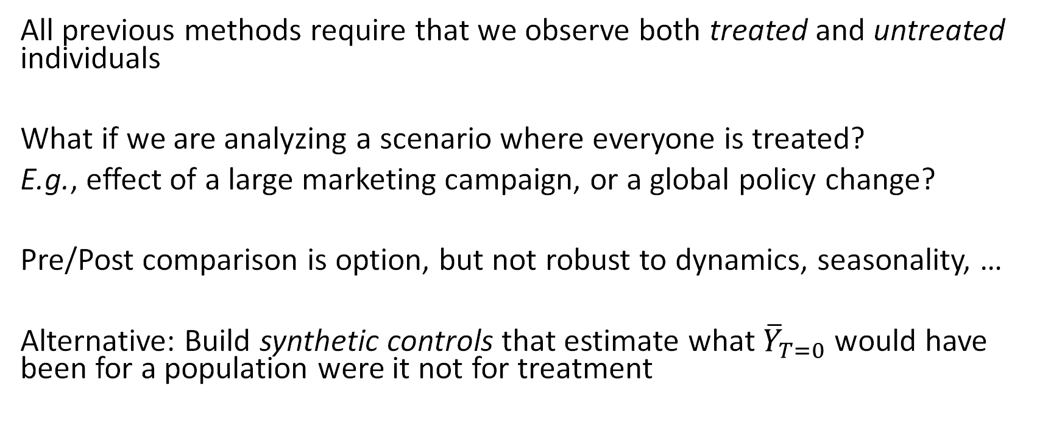
Synthetic control
All previous methods require that we observe both treated and untreated individuals
What if we are analyzing a scenario where everyone is treated?
E.g., effect of a large marketing campaign, or a global policy change?
Pre/Post comparison is option, but not robust to dynamics, seasonality, …
Alternative: Build synthetic controls that estimate what ${\overline{Y}}_{T=0}$ would have been for a population were it not for treatment

Slide 58
Synthetic controls: Intuition
1. Decide what the treatment will be
2. Pre-treatment stage: Observe the world for awhile
Record the outcome we care
Record covariates that can help us predict our observed outcome, but will not be effected by the treatment. Use domain-knowledge / theory to identify these covariates.
Learn a model that predicts outcome based on covariates.
3. Post-treatment stage:
Keep recording outcome. This is now the treated outcome.
Predict untreated outcome using learned model and current covariates
ATE = Difference between observed outcome and prediction of untreated outcome

Slide 59
Example: policy change to encourage exercise
Build model of cholesterol from pre-treatment data
Age, Restaurants,
Vegetable Prices,
…
Synthetic control (untreated) predicted from covariates
Time
Treatment effect is the difference between predicted control and observed (treated) outcome
Cholesterol
Time

Slide 60
What we just learned: Synthetic Controls
Definition | Calculate treatment effect by comparing observed outcomes of treated population with synthetic (predicted) outcomes of an untreated population
Intuition | If we can measure covariates that are unaffected by the treatment and predictive of untreated outcomes, then we can build a synthetic control
Example | Predicting effect of global policy change to encourage exercise on population-wide cholesterol
Keep in mind | Ignorability assumption must still hold; Relatedly, be concerned about generalizability/robustness of learned outcome model

Slide 61
PART II. Methods for Causal Inference
Observational Studies
Natural Experiments
Refutations

Slide 62
Part II.B. Natural Experiments
Simple natural experiment
Instrumental Variables
Regression Discontinuities

Slide 63
Natural experiments: What can we do without ignorability?
Rather than assume ignorability over the entire dataset, find data subsets that approximate an experiment.
“Natural” → as if Nature conducted an experiment for you
Common sources: Prior A/B tests, Lottery, any randomized policy, an external shock to the treatment.
Allows common causes of T and Y, as long as the source is not affected by them.

Slide 64
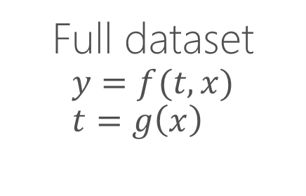


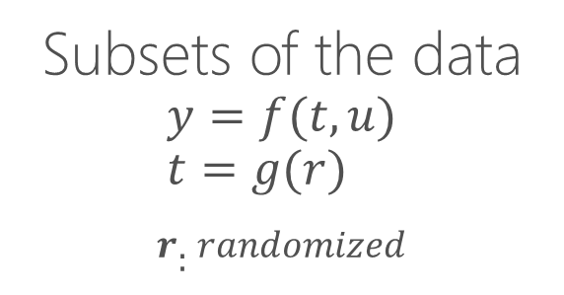
Finding a natural experiment
Expt
Expt
Expt
Expt
$$<T,Y>$$
$$<T,Y>$$
Full dataset
$$y=f(t,x) \\ t=g\left(x\right)$$
Subsets of the data
$$y=f(t,u) \\ t=g(r)$$
$$r:randomized$$
How to find such experiments?
Example: Cholera cause estimation in 1850s.

Slide 65
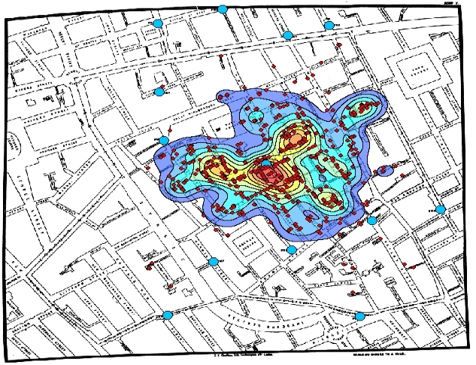
1854: London was having a devastating cholera outbreak

Slide 66
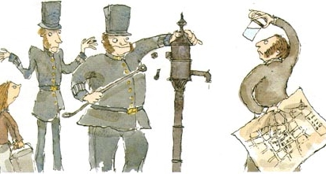
Enter John Snow. He found higher cholera deaths near a water pump, but could be just correlational.

Slide 67
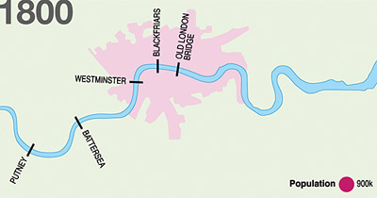
S & V WATER COMPANY
LAMBETH WATER COMPANY
New Idea: Two major water companies for London:
one upstream and one downstream.
Customers of each company distributed throughout city

Slide 68
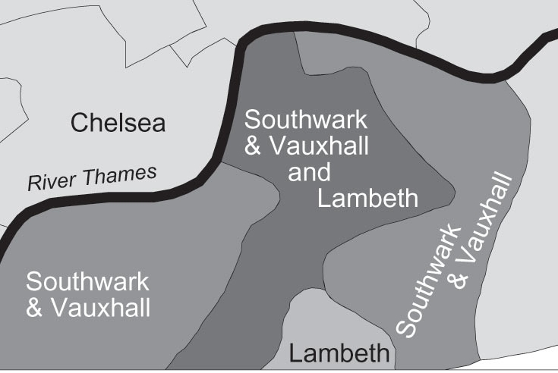
S&V
and Lambeth
No difference in neighborhood, still an 8-fold increase in cholera with the downstream company.

Slide 69
“Natural” experiments: exploit variation in observed data
Can exploit naturally occurring as-if random variation in data.
Since data is not actively randomized, as-if-random remains an assumption.
Also need exclusion: the source of variation should not affect the outcome directly, only the treatment.
Dunning (2002), Rosenzweig-Wolpin (2000)

Slide 70
What we just learned: Simple natural experiment
Definition | Exploit “as-if random” assignment of treatments to measure outcome.
Intuition | When assignment of treatment is unrelated to the measured outcome and their common causes, we can treat it as if it is a randomized experiment to estimate treatment effect.
Example | What water company do you buy from?
Keep in mind | As-if random assignments of treatments are hard to find. Estimates very sensitive to violation of exclusion assumption.

Slide 71
Part II.B. Natural Experiments
As-if Random
Instrumental Variables
Regression Discontinuities

Slide 72
Prior setup can be generalized as search for an “instrumental variable”
Other factors
[e.g. neighborhood] (U)
As-If-Random
Water Company(Z)
Contaminated Water (T)
Cholera Diagnosis (Y)
Exclusion

Slide 73


Prior setup can be generalized as search for an “instrumental variable”
Unobserved Confounders (U)
As-If-Random
$$(Z \text{∐ }\text{U}\text{)}$$
Instrument (Z)
Cause (X)
Outcome (Y)
$$(Z ∐ Y | T,U)$$
Exclusion

Slide 74
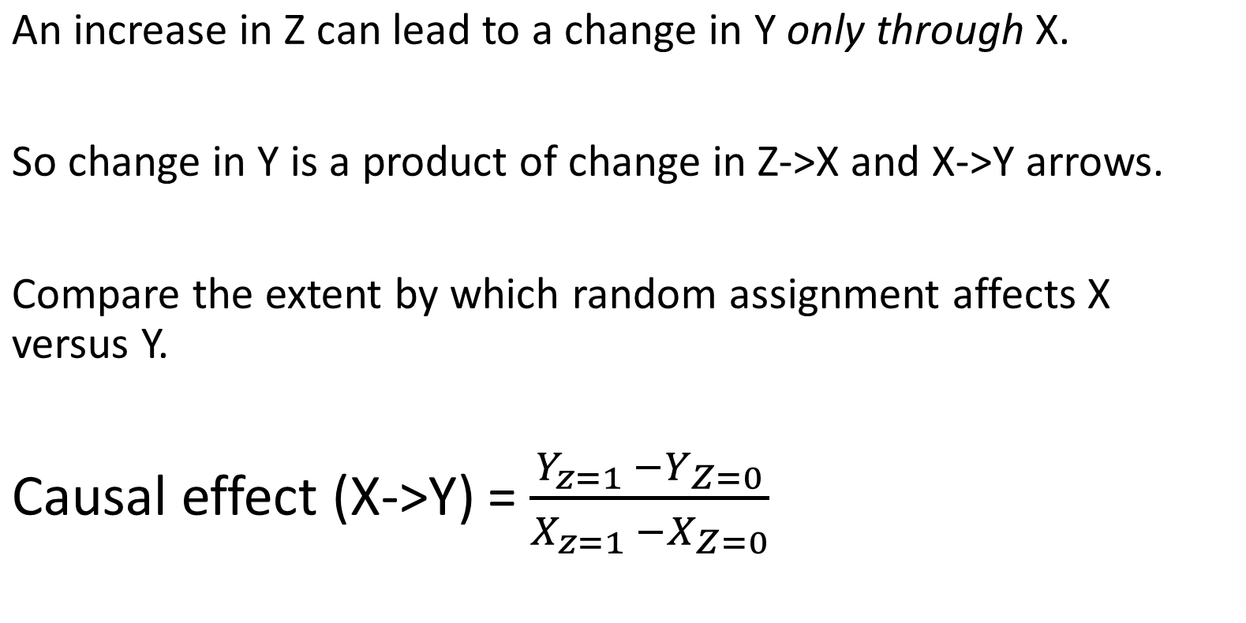
Intuition: Can use this variation to compute causal effect
An increase in Z can lead to a change in Y only through X.
So change in Y is a product of change in Z->X and X->Y arrows.
Compare the extent by which random assignment affects X versus Y.
Causal effect (X->Y) = $\frac{Y_{z=1 }−Y_{Z=0}}{X_{z=1 }−X_{Z=0}}$

Slide 75
A generalized natural experiment: Instrumental Variables
Can look at as-if random variations due to external events.
E.g.,
Experimental: Encouraging randomly selected users of an app to exercise.
Observational: Looking at a past A/B test intervention that increased chances of exercise.
Example: What is the effect of recommendations on an app store?
Instrumental Variable: External sources that drive sudden, large traffic to an app.
Angrist-Pischke (2008)

Slide 76
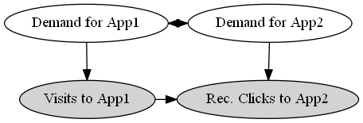
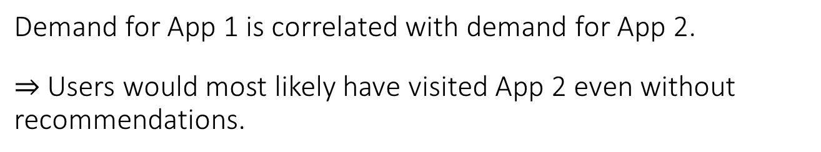
Example: Effect of store recommendations
How many new visits are caused by the recommender system?
Demand for App 1 is correlated with demand for App 2.
$⇒$ Users would most likely have visited App 2 even without recommendations.

Slide 77

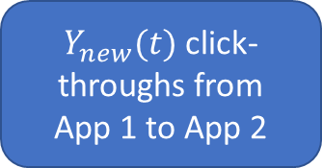
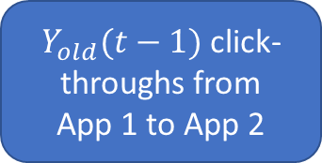
Traffic on normal days to App 1
$Y_{old}(t−1)$ click-throughs from
App 1 to App 2
Cannot say much about the causal effect of recommendations from App 1.
$Y_{new}(t)$ click-throughs from
App 1 to App 2

Slide 78
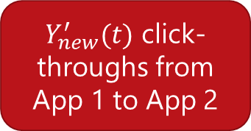
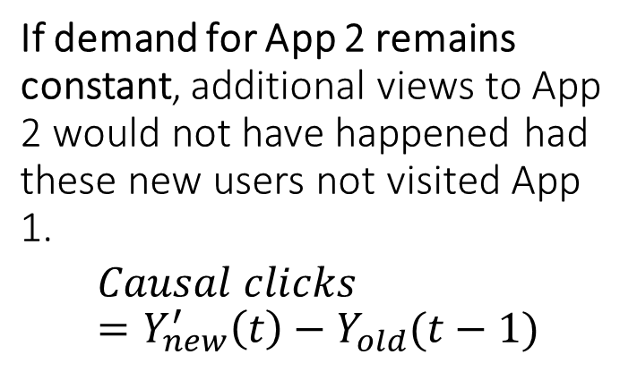
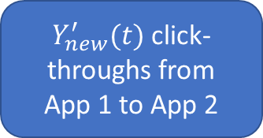
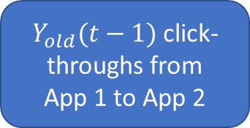
External shock brings as-if random users to App1
$Y_{old}(t−1)$ click-throughs from
App 1 to App 2
Spike in visits to App 1
If demand for App 2 remains constant, additional views to App 2 would not have happened had these new users not visited App 1.
$$Causal clicks =Y_{new}^{′}\left(t\right)−Y_{old}(t−1)$$
$Y_{new}^{′}(t)$ click-throughs from
App 1 to App 2
Sharma-Hofman-Watts (2015)

Slide 79
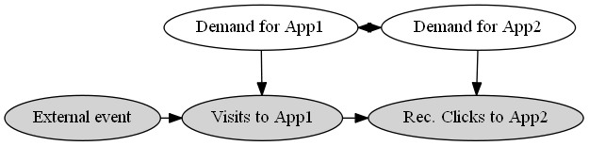
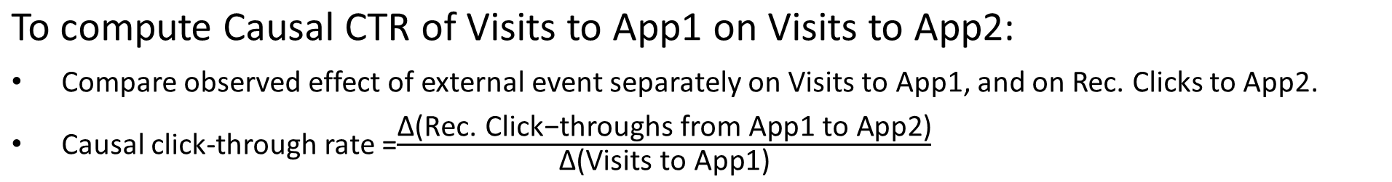
Exploiting sudden variation in traffic to App 1
To compute Causal CTR of Visits to App1 on Visits to App2:
Compare observed effect of external event separately on Visits to App1, and on Rec. Clicks to App2.
Causal click-through rate =$\frac{\text{Δ}\text{(}\text{Rec}\text{. }\text{Click}\text{−}\text{throughs} \text{from} \text{App}\text{1 }\text{to} \text{App}\text{2)}}{\text{Δ}\text{(}\text{Visits} \text{to} \text{App}\text{1)}}$

Slide 80



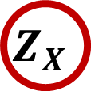



Automatically Identifying Natural Experiments
Split-Door Criterion
Finds 7,000 natural experiments, instead of 133
Result: Across 10 product categories, half of recommendation clicks would have happened anyway
$$Z_{X}$$
$$Z_{Y}$$
$$X$$
$$Y_{R}$$
$$Y_{D}$$
Sharma et al. Split-door criterion for causal identification: Automatic search for natural experiments, 2016

Slide 81
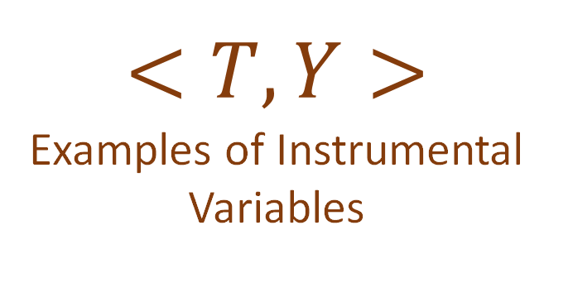
$$<T,Y>$$
Examples of Instrumental Variables
Lottery
Weather
Shocks
Discontinuities
Hard-to-find
variations
Dunning (2012)

Slide 82
But there are so many natural variations.

Slide 83







$$<T,Y>$$
Lottery
Weather
Change in access of digital services
Shocks
Discontinuities
Change in train stops in a city
Hard-to-find
variations
Change in medicines at a hospital
…

Slide 84
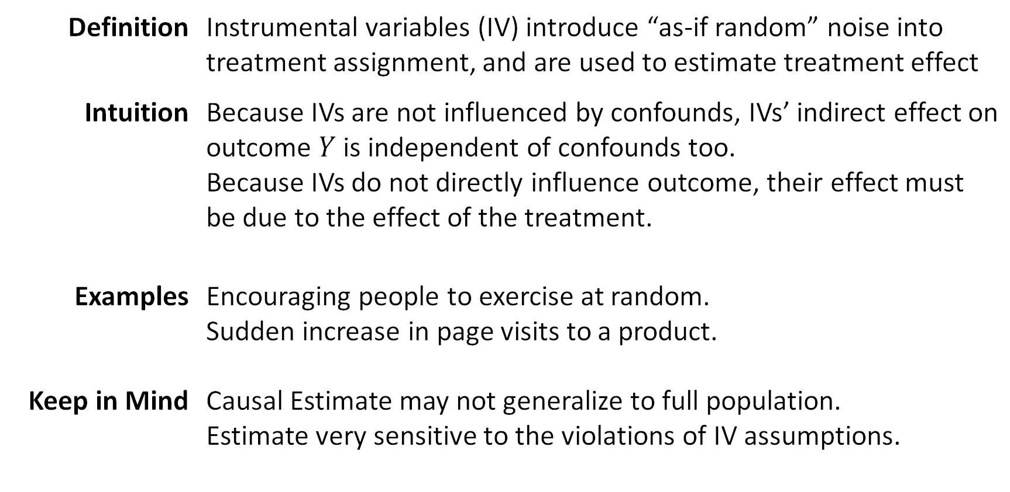
What we just learned: Instrumental Variables
Definition | Instrumental variables (IV) introduce “as-if random” noise into treatment assignment, and are used to estimate treatment effect
Intuition | Because IVs are not influenced by confounds, IVs’ indirect effect on outcome $Y$ is independent of confounds too. Because IVs do not directly influence outcome, their effect must be due to the effect of the treatment.
Examples | Encouraging people to exercise at random. Sudden increase in page visits to a product.
Keep in Mind | Causal Estimate may not generalize to full population. Estimate very sensitive to the violations of IV assumptions.

Slide 85
Part II.B. Natural Experiments
As-if Random
Instrumental Variables
Regression Discontinuities

Slide 86
Regression discontinuities: Look for arbitrary changes to treatment
Instead of an IV changing the distribution of treatment over individuals, an arbitrary change decides the treatment deterministically.
At time t, a cholesterol drug A is banned, and people switch to another drug B.
What was the relative effect of drug A over B ?
Due to selection effects, people taking drug A are different from those taking drug B.
But within [t-1, t+1] duration, patients of A and B can be assumed to be similar.
Cholesterol
Time
A

Slide 87
Regression discontinuities
Below income threshold t, free health insurance. What is effect of health insurance on cholesterol?
Due to selection effects, people with health insurance different from those without.
But within [t-1, t+1] income, people with or without health insurance are similar.
Cholesterol
Household Income

Slide 88
Regression discontinuities also depend on as-if-random and exclusion
As-if-random: People near the threshold are similar to each other, as if Nature randomized them on either side of the threshold.
Exclusion: Merely being on one side of the threshold does not affect the outcome.
Very common: Many decisions in organizations, arbitrary decisions in software are examples.
Can be thought of as a special case of an instrumental variable.

Slide 89
Example: Effect of Store recommendations
Suppose instead of comparing recommendation algorithms, we want to estimate the causal effect of showing any algorithmic recommendation.
Can be used to benchmark how much revenue a recommendation system brings, and allocate resources accordingly.
(and perhaps help analyze the tradeoff with users’ privacy)

Slide 90

Exploiting arbitrary cutoffs to recommendations
Only 3 recommendations shown to user.

Slide 91
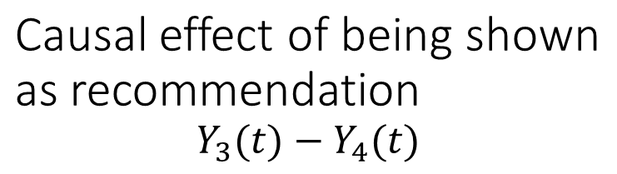
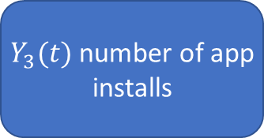
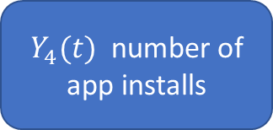
Assumption: Closely-ranked not-shown apps are as relevant as shown apps
Causal effect of being shown as recommendation
$$Y_{3}(t)−Y_{4}(t)$$
3rd ranked app (Shown)
4th ranked app
(Not-shown)
$Y_{3}(t)$ number of app installs
$Y_{4}(t)$ number of app installs
Same user

Slide 92
Algorithm: Regression discontinuity
For any top-k recommendation list:
Using logs, identify apps that were similarly ranked but could not make it to the top-k shown apps.
Measure difference in app installs between shown and not-shown apps for each user.

Slide 93
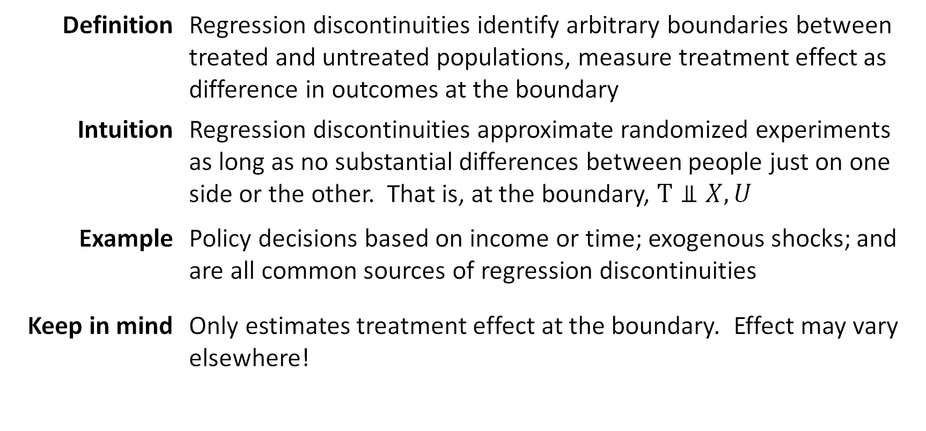
What we just learned: Regression Discontinuities
Definition | Regression discontinuities identify arbitrary boundaries between treated and untreated populations, measure treatment effect as difference in outcomes at the boundary
Intuition | Regression discontinuities approximate randomized experiments as long as no substantial differences between people just on one side or the other. That is, at the boundary, $T⫫X,U$
Example | Policy decisions based on income or time; exogenous shocks; and are all common sources of regression discontinuities
Keep in mind | Only estimates treatment effect at the boundary. Effect may vary elsewhere!

Slide 94
PART II. Methods for Causal Inference
Observational Studies
Natural Experiments
Refutations

Slide 95
Causal inference is only possible with assumptions
“Causal” part does not come from the data.
It comes from your assumptions that lead to identification.
The data is simply used for statistical estimation.
Critical to verify your assumptions. But how?

Slide 96
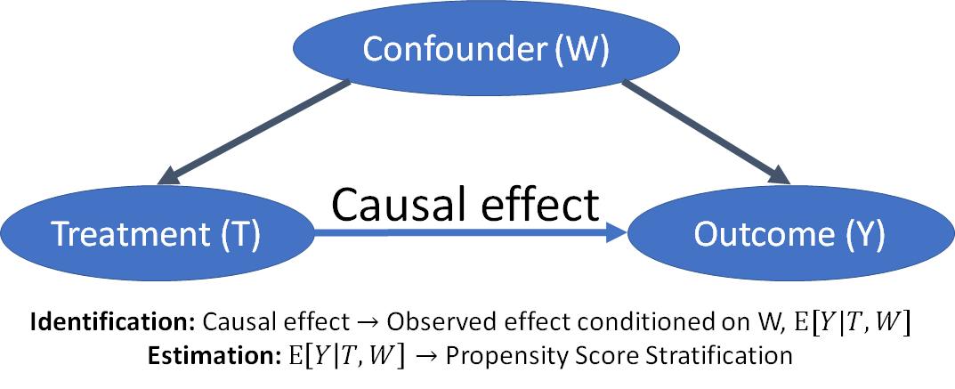
(Step 1): Making explicit the difference between identification and estimation
Why do observational studies fail? Most likely due to errors in identification.
--Estimation is a statistical problem, relatively easy.

Slide 97
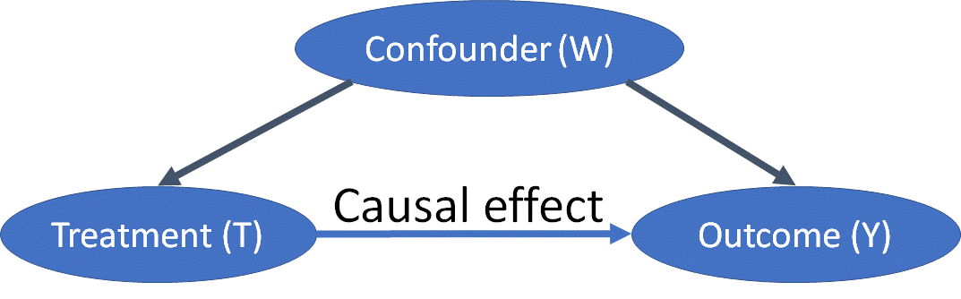
(Step 2): Explicitly represent your identifying and estimating assumptions.
Identifying assumption: All the arrows missing in the causal graphical model. E.g. No other common cause exists -> Untestable in general.
Estimating assumption: Overlap between treated and untreated population. Can be solved by collecting more data.

Slide 98
(Step 3): Refute your assumptions, and analyze your estimate’s sensitivity to violations
Identifying assumption: All the arrows missing in the causal graphical model. E.g. No other common cause exists -> Untestable in general.
-- What happens when another common cause exists?
-- What happens when treatment is placebo?

Slide 99
To make these steps easy, we created DoWhy: a python library for causal inference
DoWhy focuses attention on the assumptions required for causal inference.
Provides estimation methods such as matching and IV so that you can focus on the identifying assumptions.
-- Models assumptions explicitly using causal graphical model.
-- Provides an easy way to test them (if possible) or analyze sensitivity to violations.
Unifies all methods to yield four verbs for causal inference:
-- Model
-- Identify
-- Estimate
-- Refute

Slide 100

DoWhy: Sample causal inference analysis in 4 lines

Slide 101
Refutation 1: Add random variables to your model
Can add randomly drawn covariates into data
Rerun your analysis.
Does the causal estimate change? (Hint: it shouldn’t)

Slide 102
Refutation check 2: Replace treatment by a placebo (A/A test)
Randomize or permute the treatment.
Rerun your analysis.
Does the causal estimate change? (Hint: it should become 0)

Slide 103
Refutation Check 3: Divide data into subsets (cross-validation)
Create subsets of your data.
Rerun your analysis.
Does the causal estimate vary across subsets? (Hint: it shouldn’t vary significantly)

Slide 104
Refutation Check 4: Test Balance of Covariates
Many methods (e.g., matching, stratification, weighting, regression discontinuity) depend on balancing of covariates
Can test this.

Slide 105
When refutations are not possible? Sensitivity Analysis to violations of assumptions
Question: How sensitive is your estimate to minor violations of assumptions?
E.g. How big should the effect of a confounder be so that your estimate reverses in direction?
Use simulation to add effect of unknown confounders.
Domain knowledge helps to guide reasonable values of the simulation.
Make comparisons to other known estimates.

Slide 106
Example: Does smoking cause lung cancer?
Demographics
Genes
Smoking
Lung Cancer
Cornwell (1959) showed that the effect of Genes had to be 8 times any known confounder for the effect to go to zero.

Slide 107
Observational causal inference: Best practices
Always follow the four steps: Model, Identify, Estimate, Refute.
Refute is the most important step.
Aim for simplicity.
If your analysis is too complicated, it is most likely wrong.
Try at least two methods with different assumptions.
Higher confidence in estimate if both methods agree.

Slide 108
Try out DoWhy to see best practices in action
DoWhy: A Python Library for Causal Inference
Principled: Converts prior knowledge to a formal causal graph
Simple: Automated analysis of many assumptions, one line of code for powerful causal inference algorithms
Robust: Battery of tests to refute obtained estimates
Modest: No estimate if the data is insufficient
Input: Observational data, Causal graph
Output: Causal effect between desired variables, “What-if” analysis
Code: https://github.com/Microsoft/dowhy
Docs: http://causalinference.gitlab.io/dowhy

Slide 109
PART I. Introduction to Counterfactual Reasoning PART II. Methods for Causal Inference PART III. Large-scale and Network Data PART IV. Broader Landscape

